Slide 1
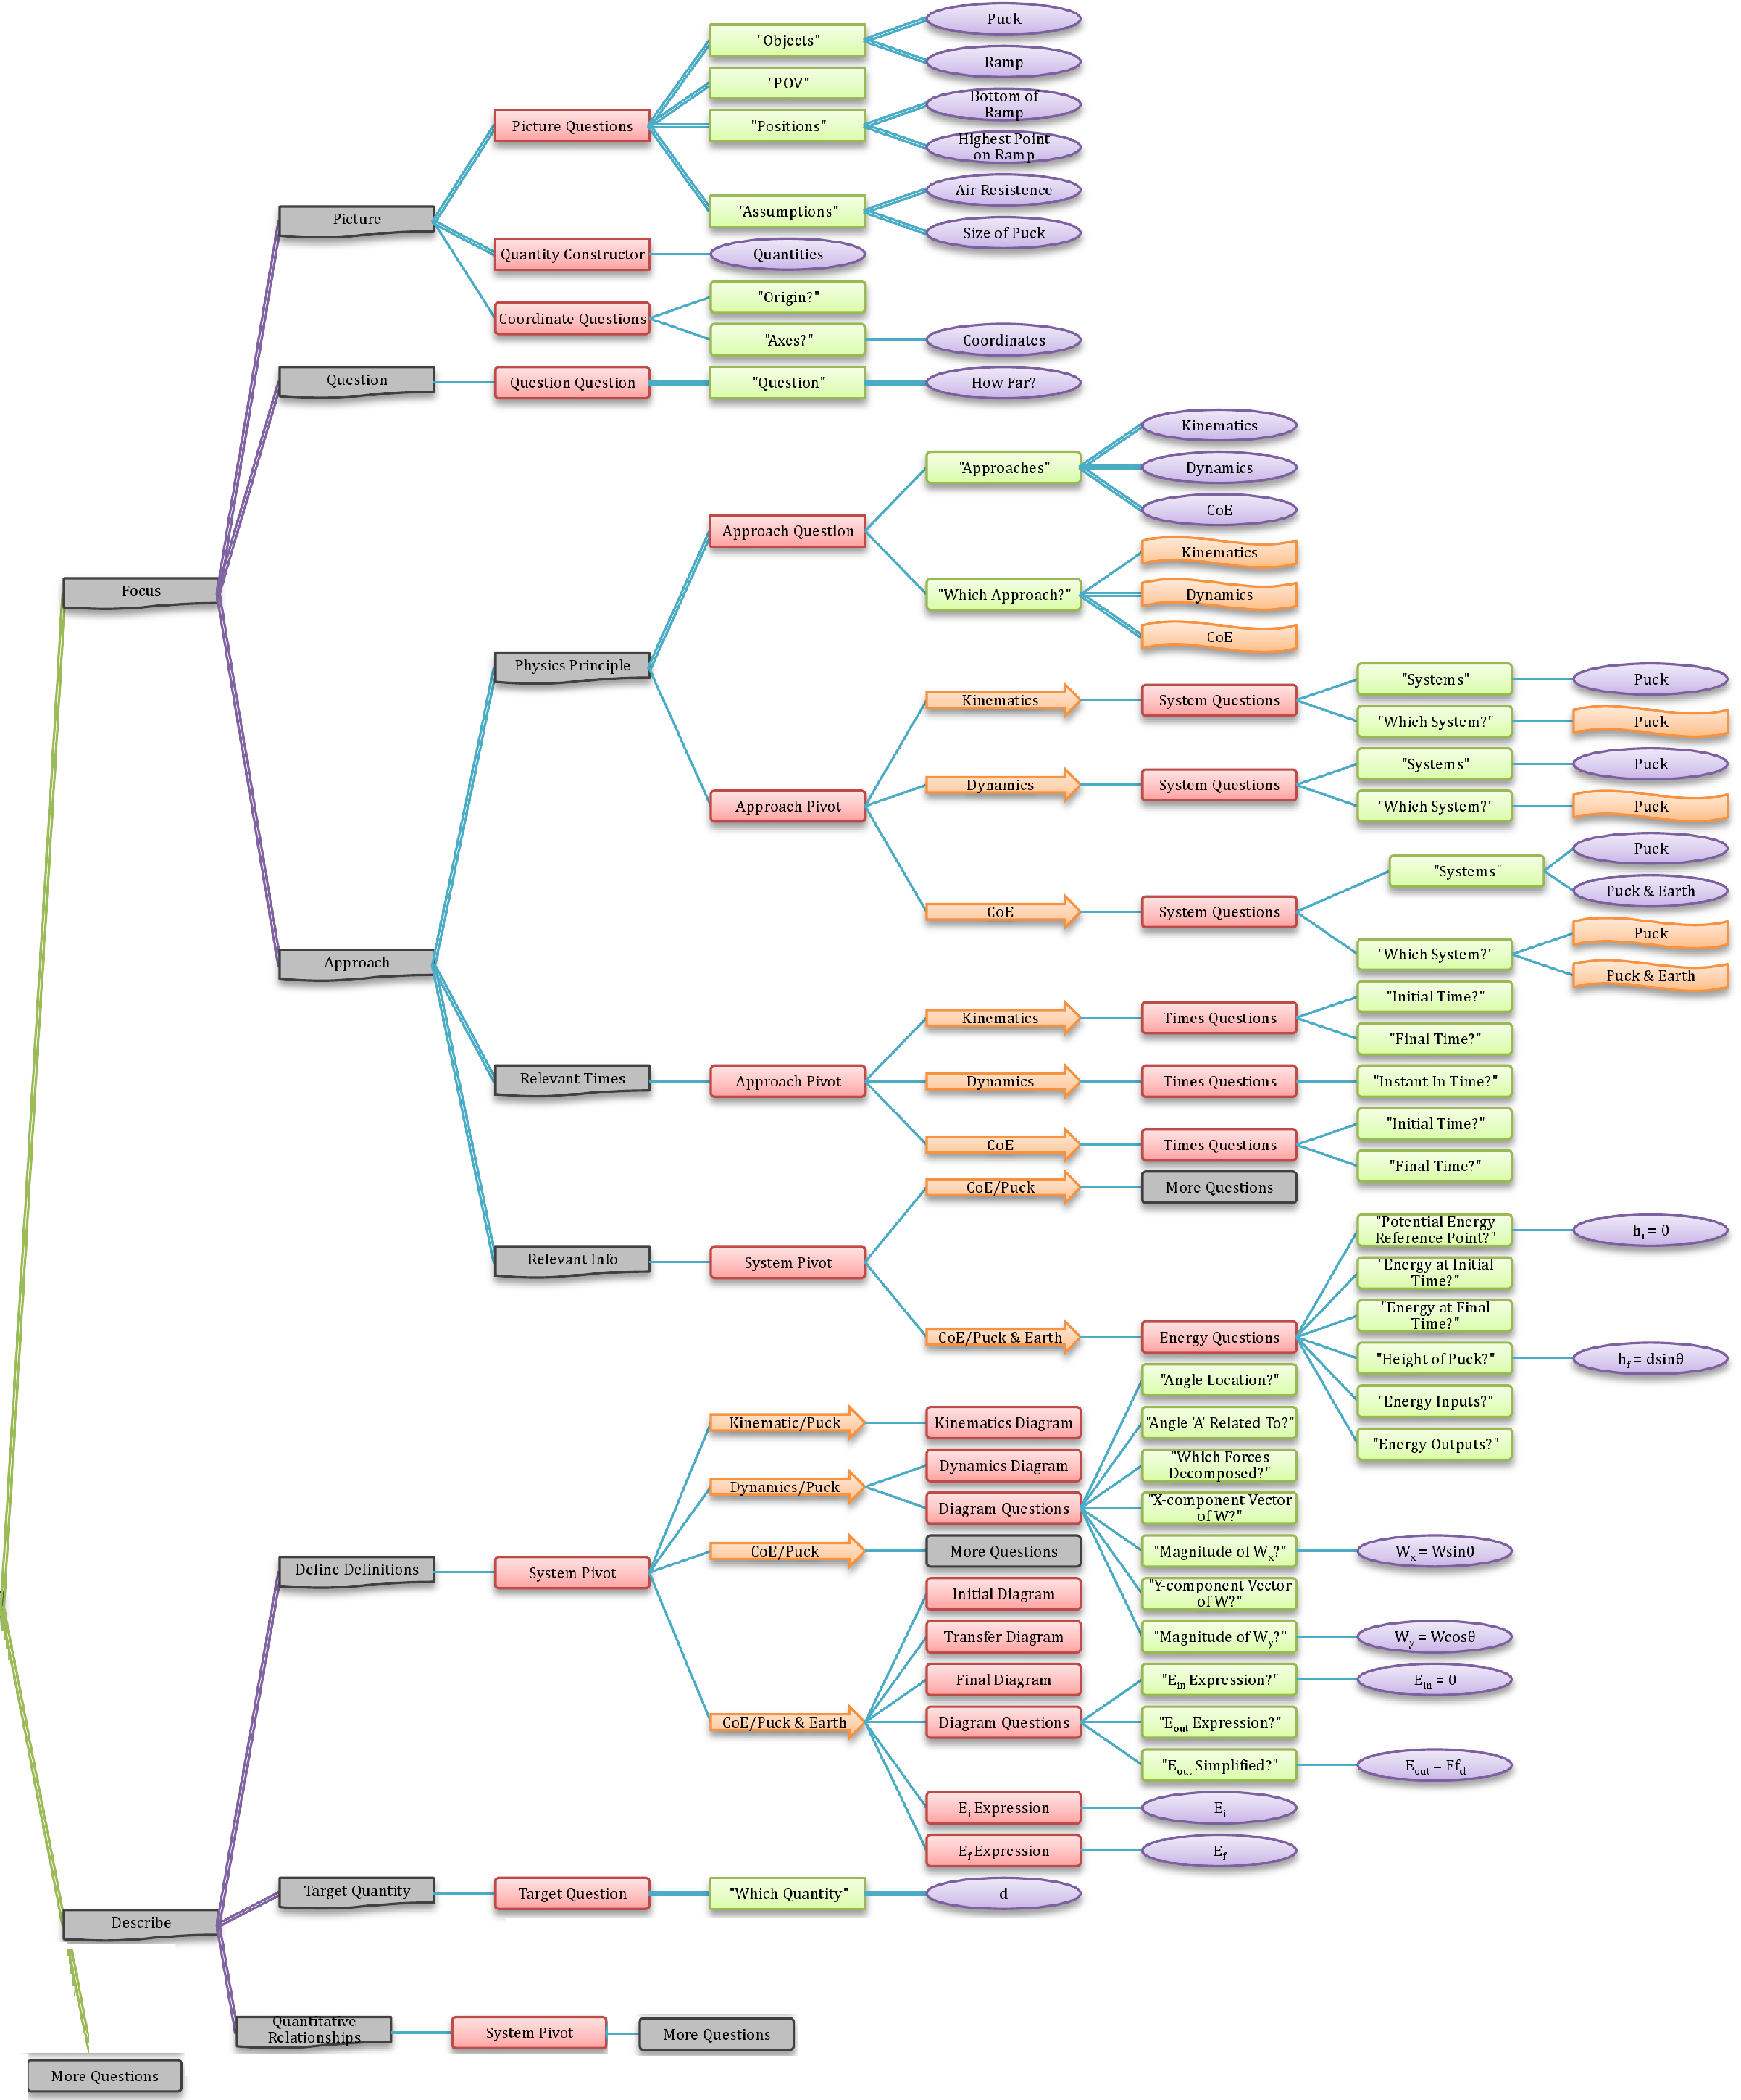
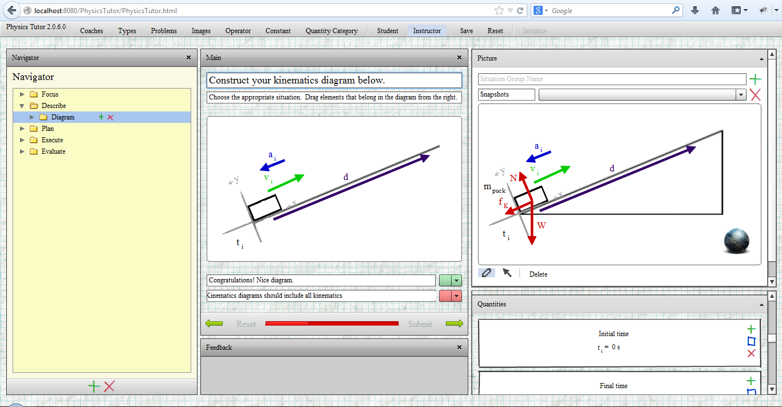
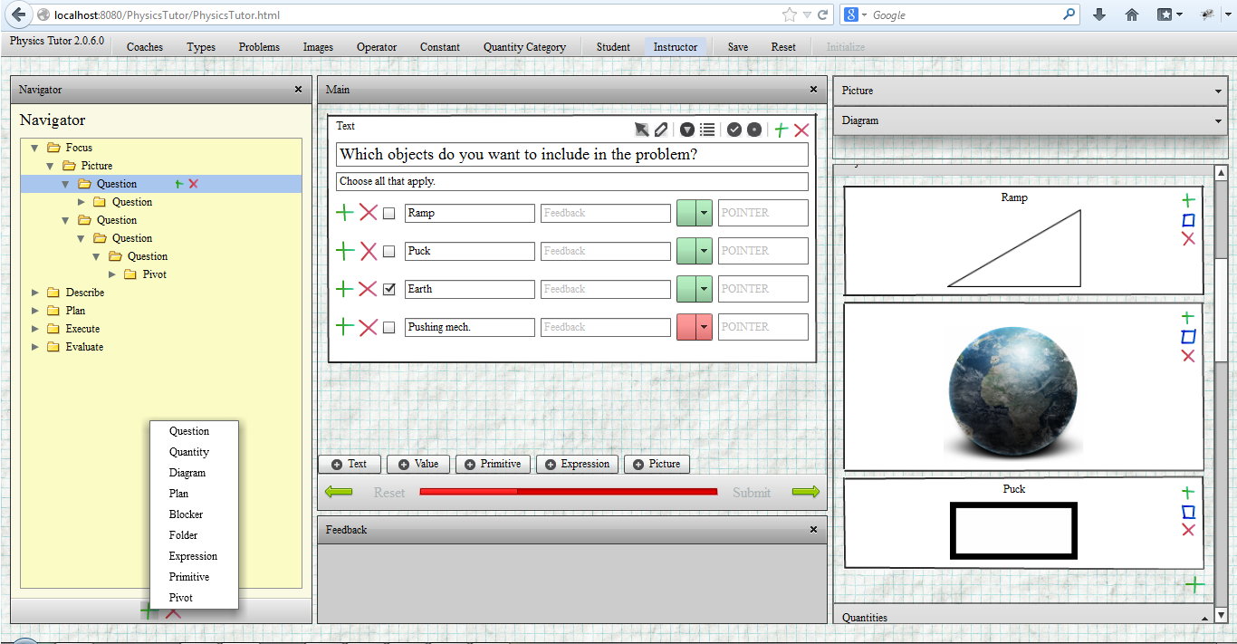
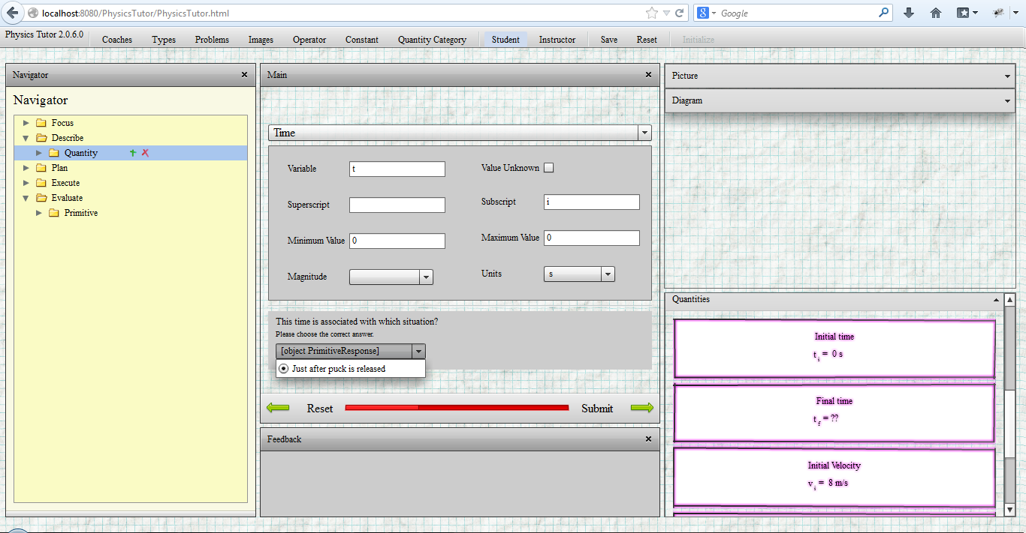
DEVELOPING A FRAMEWORK FOR PROBLEM SOLVING COMPUTER COACHES
General v2 Coach Structure
Supported in part by the National Science Foundation
DUE-1226197 and the University of MN
“Primitive” Elements are treated as objects which are unlocked through the solving process.
Evan Frodermann¹, Qing (Xu) Ryan¹, Kristin Crouse ¹, Ken Heller¹, Leon Hsu ², Bijaya Aryal³
1. School of Physics and Astronomy, University of Minnesota –Twin Cities
2. Department of Postsecondary Teaching and Learning, University of Minnesota –Twin Cities
3. Center for Learning Innovation, University of Minnesota – Rochester
Goal and design
Expand the usability and effectiveness of an earlier version (v1) of online computer coaches of problem solving.
Follow framework of a cognitive apprenticeship model.
The new version (v2) of the coaches focus on addressing some limitations of the v1 coaches.
Procedural limitations of v1.
Over-repetitiveness of v1
Refocus the coaches to the learning needs of a defined target student population.
Ease of use to designing coaches in v2 for instructors
35 computer v1 coaches were incorporated into calculus-based introductory mechanics courses
Data collected from students as well as instructor feedback were used to motivate the redesign of our coaching framework.
Data collected from students included:
FCI, CLASS, and a math diagnostic tests.
Midterm and end of term surveys about the version 1 coaches in Spring 2013.
Keystroke data from coaches.
The v2 coaches will also be implemented into calculus-based electromagnetism courses to explore usefulness in a new course.
Computer Coaches – Instructor’s Perspective
In version 1, instructors needed programming skills to modify coaches.
In version 2, coaches can be duplicated and modified using a graphical user interface (GUI).
Adobe Flash
All information is stored in a SQL database. Interacts with Flash frontend through Java host server (Apache Tomcat).
In version 1, adding and manipulating graphics was difficult and done externally.
In version 2, all pictures and diagrams are stored in the SQLDB and manipulated within the GUI interface.
In version 1, students cannot switch solutions paths once chosen.
In version 2, students can “freely” choose how to solve the problem from available instructor-specified paths.
These paths are completely adjustable to the instructors course needs.
Picture elements are added to the database through the interface.
Coaches are edited in the “instructor” view
Users navigate to different “parent” elements at any time through this menu.
“Primitive” elements are unlocked for the student after correct responses.
Instructor
Clients
Server Host
Adobe Flash Player and internet connection
Java Web server
Apache Tomcat
MySQL database
Students unlock elements of the diagram dynamically and drag unlocked elements to create diagram.
All software based on free, open source packages.
Instructors edit pictures and diagrams within the GUI.
“Children” elements are only unlocked for the student with correct responses to questions.
Students
Computer Coaches – Student’s Perspective
Positives
End-term survey
“The computer coaches did not help improve my problem solving in this class”
66% of the 135 responses either “disagreed” or “strongly disagreed”
Midterm survey; Free response question.
“What do you like most about the computer coaches?”
23% of 183 responses either mentioned “step by step” or “guide from beginning to end”.
Shortcomings
Midterm survey
“Using the computer coaches made the homework take too long”
49% of the 183 responses either “agree” or “strongly agree”
Midterm survey; Free response question
“What do you like least about the computer coaches?”
37% of the 183 responses either mentioned that they were “too long” or “too repetitive”.
One of the design goals is to be adaptable to the diverse desires of the student.
Reduce this time and over repetition for students who desire it.
Student controls the “grain size” of the coach
In version 1, every kinematic quantity defined whether useful or not, with the same set of questions.
In version 2, only useful quantities are defined using comprehensive modules; eg. the “quantity module”.
Coaches are solved in the “student” view
Quantities required to solve the problem must be defined. Other quantities can also be defined.
Quantity categories are defined by instructor which include a list of required responses.
A more detailed analysis of the usage and usability data is shown at poster PST2C14.
Students choose which quantities to define with these minimal responses.

